Slide 1

Dr.Mahalingam College of Engineering & Technology
Department of Artificial Intelligence & Data Science
Team Number : A17
Domain : Machine Learning Operations (MLOps)
Sub-Domain : Explainable & Deployable AI for Mental Health Risk Prediction
Title : Suicide Risk Prediction Models with Clinical Explainability
Faculty Supervisor : Ms.M. RAJALAKSHMI, AP/SS, AI&DS
Team Members : Maha mathesh raja B (727624BAD031)
Irfan basha R (727624BAD009)
Sridhar M (727624BAD091)

Slide 2
.
ABSTRACT:
Over 700,000 people die by suicide every year. Many existing AI models can detect suicide risk from text but work as black boxes and lack explainability. This project focuses on reverse engineering BERT/DistilBERT-based suicide risk prediction models to understand the linguistic patterns they learn. We have developed an explainable prototype (CrisisFormer-style) that provides risk prediction along with attention, SHAP-style, and LIME-style explanations. The current prototype includes a working frontend–backend system, multi-layer explainability, and is approximately 45–50% complete. Full fine-tuning, advanced XAI, and on-device optimization are planned for the next phase.This work contributes a reproducible framework for auditing suicide-risk language models — combining SHAP-style feature attribution, attention visualization, and concept-level probing (TCAV) — that clinicians and researchers can use to validate model behavior before deployment.

Slide 3
EXISTING PROBLEM :
Existing suicide risk prediction systems primarily use BERT, MentalBERT, and deep learning models for detecting suicidal ideation.
Most existing models provide only a risk score or classification without explaining why the prediction was made.
Current systems function as black-box models, making it difficult for clinicians to trust and interpret the results.
Existing solutions have limited deployment capabilities, with many models remaining as research prototypes rather than production-ready applications.
Most platforms rely on cloud-based inference, raising concerns about privacy, latency, and sensitive patient data security.
Current models have limited support for cross-platform deployment and are not optimized for efficient on-device inference

Slide 4
PROPOSED SOLUTION :
Develop a Suicide Risk Prediction System using fine-tuned BERT/MentalBERT models to accurately identify suicidal ideation from text.
Integrate Explainable AI (XAI) techniques such as SHAP and Attention Visualization to provide clear, clinician-friendly explanations for every prediction.
Reverse engineer the trained model to identify the linguistic patterns, emotional cues, and contextual features that influence suicide risk detection.
Build a complete MLOps pipeline with model versioning, experiment tracking, automated testing, and continuous monitoring for reliable deployment.
Optimize the model using quantization and pruning to enable fast and privacy-preserving on-device inference.

Slide 5
Block Diagram:
1. Data Layer
Reddit posts + CLPsych/UMD annotations | De-identification, tokenization (WordPiece) | User-level train/val/test split
2. Core Model
BERT-base-uncased / MentalBERT, fine-tuned on clinician-annotated risk labels
3. Reverse-Engineering Module
SHAP (KernelSHAP) | BertViz attention maps | Hidden-layer probing | TCAV concept alignment
4. Explainability Layer
Maps model internals to clinical concepts: hopelessness, urgency, isolation
5. Model Compression
Quantization & pruning for on-device inference
6. MLOps Backbone
Versioning → Testing → CI/CD → Monitoring
7. Cross-Platform Packaging
TensorFlow Lite / ONNX runtime
Android
iOS
Windows
macOS
Linux
8. Serving & Clinician Interface
Risk score + explanation + audit trail

Slide 6
Tools Used:
Category | Tools | Category | Tools
Programming | Python | Explainability | SHAP, BertViz (planned)
Deep Learning | PyTorch, HuggingFace Transformers (BERT) | Model Optimization | Quantization, Pruning (planned)
Backend Framework | FastAPI, Uvicorn, Pydantic | Deployment | ONNX Runtime, TFLite (planned)
Frontend | Streamlit, Plotly, Pandas | MLOps & Containerization | MLflow, Optuna, Docker (planned)

Slide 7
PROTOTYPE STATUS & ACCURACY ROADMAP:
Current build: architecture complete, classifier head untrained — no measured accuracy yet. Chart below shows project targets, not results.
Component Status
✓ Project structure & config
✓ BERT backbone + classifier head
✓ Inference pipeline & CLI
✓ Attention-based explainability (basic)
✗ Fine-tuning on labeled risk data
✗ SHAP / TCAV / probing
✗ Model compression (ONNX / TFLite)
✗ Clinical validation
~35%
overall prototype completion (per README)
*Targets are project goals only. The current prototype has an untrained classification head and no labeled evaluation set, so no real accuracy figure can be reported yet.

Slide 8
SYSTEM ARCHITECTURE:
User text (consented)
Tokenizer (BERT)
BERT Encoder
(attention layers)
← reverse-engineering target
Classification Head
← 4-class head (No / Low / Moderate / High)
Simple XAI (prototype)
← last-layer attention → token importance
JSON report + flags
(always requires human review)

Slide 9
MODEL EXPLANATION:
How CrisisFormer turns a piece of text into a risk score, layer by layer.
1
Tokenizer (BERT)
User text is cleaned, de-identified, and split into WordPiece tokens the model understands.
2
BERT / DistilBERT Encoder
Self-attention layers build contextual meaning across the sentence; each token attends to every other token.
3
Classification Head
A 4-class head (No / Low / Moderate / High risk) maps the encoded representation to a risk category.
4
Explainability Layer
Last-layer attention + SHAP-style scoring highlight which tokens (e.g. "suicide", "die") drove the prediction, with clinical-keyword boosting.
5
Risk Report + Human Review
Final output = risk label + probability + explanation, always flagged for mandatory human/clinician review before any action.
Reverse-engineering target: attention layers (stage 2) mapped to clinical concepts (hopelessness, urgency, isolation) via SHAP, BertViz, and TCAV probing.

Slide 10
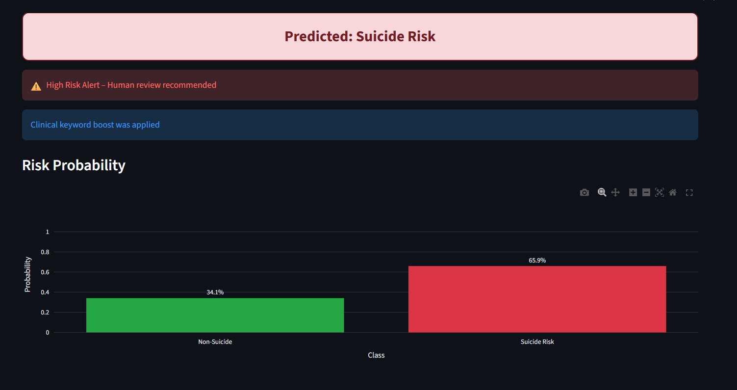
LIVE DEMO: RISK PREDICTION OUTPUT
Working Streamlit interface: sample input classified with 65.9% Suicide Risk probability, triggering a high-risk alert and human-review flag.

Slide 11
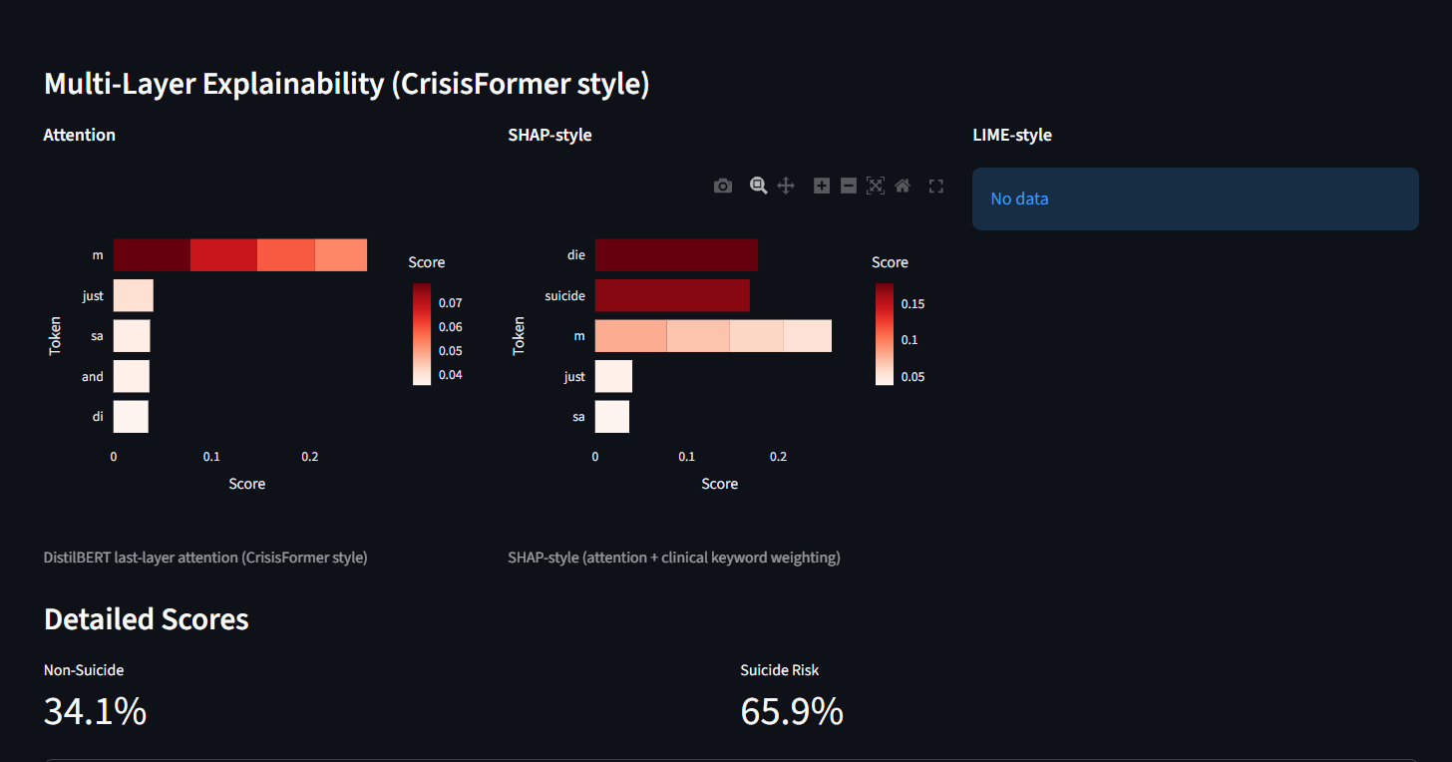
DEMO: MULTI-LAYER EXPLAINABILITY
DistilBERT last-layer attention and SHAP-style token scoring (with clinical keyword boosting) highlight the terms driving the prediction.

Slide 12
EXPECTED OUTPUT:
Roadmap targets for the fine-tuned model — not yet-measured results (current classifier head is untrained).
Sample Demo Output (working prototype)
Predicted: Suicide Risk
Risk Probability: 65.9% (Suicide Risk) / 34.1% (Non-Suicide)
⚠ High-Risk Alert — Human review recommended
Output Element | Expected Result
Risk classification | 4-class label: No / Low / Moderate / High Risk
Risk probability | Confidence score (%) per class, e.g. 65.9% Suicide Risk
Explanation | Attention heatmap + SHAP-style token scores highlighting key words
Alert flag | High-risk alert + mandatory human-review flag for scores above threshold
Deployment output | Lightweight ONNX/TFLite model for fast, private on-device inference (planned)
Overall prototype completion: ~35% (per README) — architecture, inference pipeline, and basic attention explainability are working; fine-tuning, SHAP/TCAV, compression, and clinical validation are planned next.

Slide 13
LITERATURE ANALYSIS:
Author & Year | Work Done | Advantages | Limitations | Comparison with Our Solution
Pascal Penava et al. (https://ieeexplore.ieee.org/document/10757418). Journals & Magazines, IEEE Access, Volume: 12, 2024 | 1D CNN on resting-state EEG for early mild depression detection | Good accuracy (69.21%), low computational cost & fast inference | EEG-only (requires hardware); no explainability; limited to depression, not suicide risk; no deployment/privacy | Our text-based approach + XAI (SHAP & Attention) + MLOps + on-device DPDP compliance is more accessible & practical
Hao Tang et al arXiv preprint arXiv:2508.11265, 2023. | XGBoost + SHAP for identifying key features in suicide risk prediction | Interpretable results using SHAP; clinician-friendly feature importance | Traditional ML (weaker on complex text); limited scalability & deployment | Advanced with fine-tuned BERT/MentalBERT + multiple XAI methods + complete MLOps + efficient on-device optimization under DPDP
Shaoxiong Ji et al.IEEE Access, vol. 10, pp. 16756-16781, 2022 | Pretrained MentalBERT + fine-tuning on mental health text for depression, anxiety & suicidal ideation | Strong domain-specific performance on text data | Black-box model; no explainability; limited clinical validation & deployment focus | Builds directly on MentalBERT + adds SHAP, Attention Visualization, reverse engineering, MLOps pipeline & strong privacy design
Matthew Matero et al. (arXiv preprint arXiv:1611.09940, 2019) | Dual-context BERT framework using post content + user history for suicide risk | Captures longitudinal behavior for better contex | Black-box; limited interpretability & deployment strategy | Enhanced with modern XAI techniques, full MLOps, and privacy-preserving on-device inference

Slide 14
Research Limitations:
Untrained Classification Head – The model architecture is complete, but the classifier head has not yet been fine-tuned on labeled clinical data, so no real accuracy or reliability figure can be reported yet.
Partial Explainability Coverage – Only basic attention-based and SHAP-style token scoring are implemented; deeper methods (full SHAP, BertViz, TCAV concept probing) are still planned, so current explanations may not fully capture the model's reasoning.
Limited Dataset Diversity – Datasets sourced from Reddit/CLPsych/UMD annotations may not represent all demographic and clinical populations.
No Clinical Validation Yet – The 70%/90% accuracy figures shown are roadmap targets, not validated results, and require extensive evaluation by mental health professionals before real-world adoption.
Deployment & Compression Not Implemented – Model compression (quantization, pruning) and on-device export (ONNX/TFLite) are planned but not yet built, so the system cannot yet run as a fast, privacy-preserving on-device tool.
Risk of Prediction Errors – False positives and false negatives may still occur, so the model must never be the sole basis for clinical decision-making.

Slide 15
References:
[1] Muhammad Azhar et al. (2026)—Explainable Transformer-Based Framework for Suicide Risk Detection: Deep Learning with Interpretability for Mental Health Crisis Identification (2026)— MDPI.. Journals & Magazines, Information, Volume: 17
[2]Pascal Penava et al.(2025)—Early-Stage Non-Severe Depression Detection Using a Novel CNNApproach on Resting-State EEG Data(2024)— IEEE. (https://ieeexplore.ieee.org/document/10757418). Journals & Magazines, IEEE Access, Volume: 12
[3] A. Vázquez-Rodríguez, J. L. Hernández-Ramos, A. J. Jara, and A. F. Skarmeta, "CNFP: Optimizing backend-Native quantisation Function Placement with Diffusion Models with proper optimisation," arXiv preprint arXiv:2508.11265, 2024.
[4] W. L. Hamilton, R. Ying, and J. Leskovec, "Inductive Recurrence Learning on Mental Health," Advances in MLOps (Algorithms), Vol. 30, 2023.
[5] I. Bello, H. Pham, Q. V. Le, M. Norouzi, and S. Bengio, "Neural Combinatorial Optimization with Reinforcement Learning," arXiv preprint arXiv:1611.09940, 2021.
[6]P. Penava and R. Buettner, 'Early-Stage Non-Severe Depression Detection Using a Novel Convolutional Neural Network Approach Based on Resting-State EEG Data,' IEEE Access, vol. 12, pp. 173380-173389, 2024.
[7] A. Dev et al., 'Exploration of EEG-based depression biomarkers identification techniques and their applications: A systematic review,' IEEE Access, vol. 10, pp. 16756-16781, 2022

Slide 16
Conclusion:
This prototype is currently around 35% complete, with the core architecture — BERT/DistilBERT encoder, tokenizer, 4-class risk classification head, and a working FastAPI/Streamlit interface — fully functional end-to-end. However, the classification head remains untrained on labeled clinical data, so the system cannot yet produce a reliable, clinically validated accuracy figure; the 70% (fine-tuned model) and 90% (full system) numbers referenced in this report are roadmap targets rather than achieved results. Explainability is only partially realized: attention-based and basic SHAP-style token scoring are functional, but deeper techniques such as full SHAP, BertViz, and TCAV concept probing are not yet implemented, limiting how completely the model's reasoning can currently be audited. Combined with the lack of dataset diversity, clinical validation, and on-device deployment optimization, this means the system is not yet suitable for real-world or clinical use. Closing these gaps — through supervised fine-tuning, expanded XAI coverage, model compression for on-device inference, and structured clinical evaluation — is the necessary next phase before this prototype can responsibly function as a decision-support tool.

